Slide 1

TLA+ Introduction
Changjian (CJ) Zhang
Carnegie Mellon University
Models of Software Systems
Fall 2020

Slide 2
TLA+ Overview
TLA+ is created by Dr. Leslie Lamport in 1999.
Widely used in verifying distributed algorithms.
Industrial use:
Amazon (S3, DynamoDB, EBS, EC2)
Microsoft (Azure Cosmos DB)
PingCAP (TiDB)
MongoDB
OpenComRTOS
Academic use:
Paxos
Raft
Pastry

Slide 3
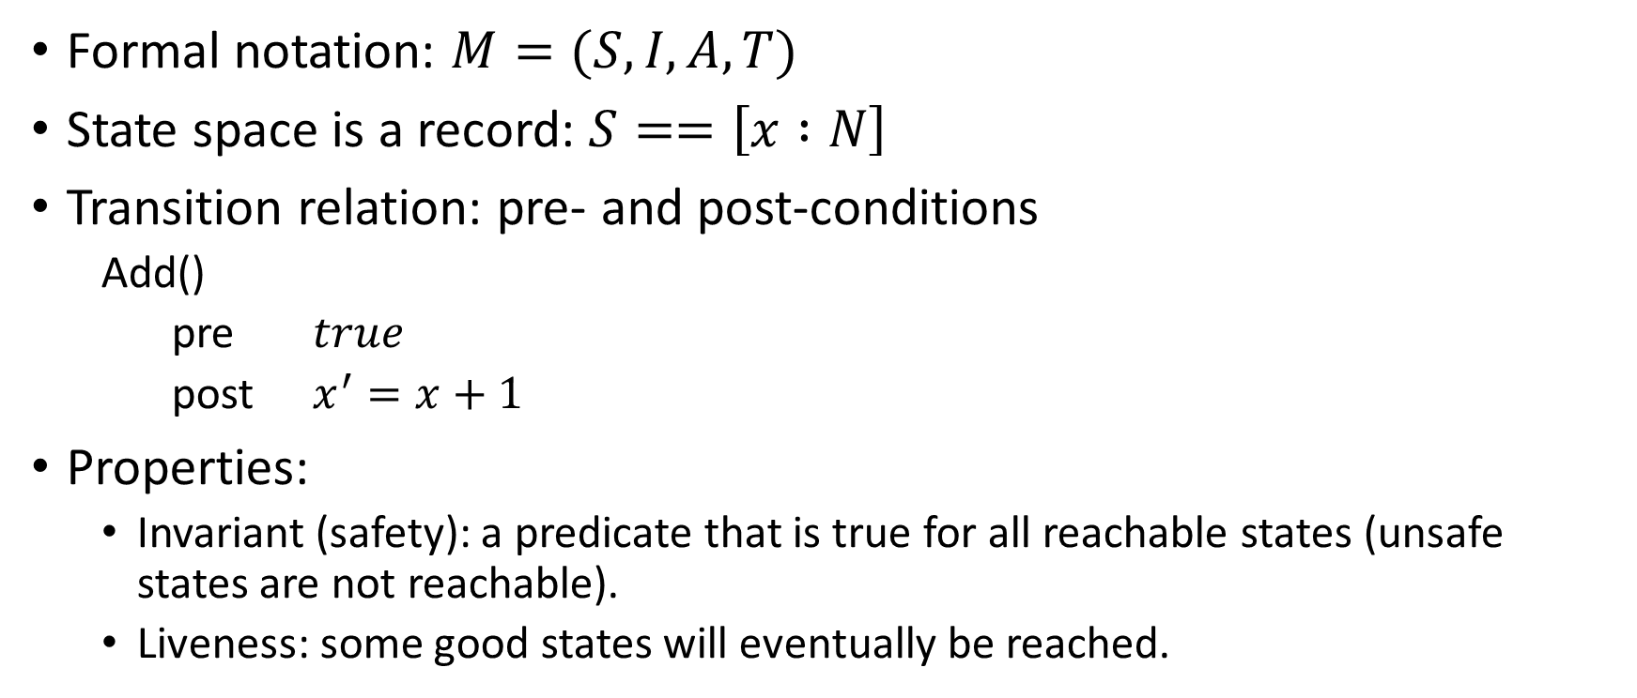
Formalism: State Machine
Formal notation: $M=(S, I, A, T)$
State space is a record: $S==\left[x :N\right]$
Transition relation: pre- and post-conditions
Add()
pre $true$
post $x^{′}=x+1$
Properties:
Invariant (safety): a predicate that is true for all reachable states (unsafe states are not reachable).
Liveness: some good states will eventually be reached.

Slide 4
Library Example
Consider a simple library that supports:
Check out a copy of a book
Return a copy of a book
Add a copy of a book
Remove a copy of a book
Get the books written by a particular author
Notes:
First, define the types of data in this universe.

Slide 5
Book Copies
Use CONSTANT keyword to define an atom or a set of atoms of the same type.
CONSTANT Author, Title, Subject, ID
\* The record type representing the book copies.
Copy == [
author : Author,
title : Title,
subjects : SUBSET Subject,
id : ID
]
Use records to define compound data structures.

Slide 6
Book Checkout Information
CONSTANT Null
CONSTANT Person
Status == { "In", "Out" }
Record == [
\* Whether the book is checked out or not
status : Status,
\* The last person checking out the book, or Null.
lastuser : Person \cup {Null}
]
Can also explicitly define a set of values.
Notes:
Next, we should define the state space of this model, in other words, the state variables.

Slide 7
State Variables
Use VARIABLES keyword to define state variables
VARIABLES books, records, users, staff
TypeInv ==
/\ books \in SUBSET Copy
\* records is a total function! The copy which has
\* not been added to the library should
\* map to Null.
/\ records \in [Copy -> Record \cup {Null}]
/\ users \in SUBSET Person
/\ staff \in SUBSET Person
TLA+ is untyped, so usually we use a type invariant to ensure that each variable belongs to a particular type.
[S -> T] represents a total function from S to T.

Slide 8
Adding a book
AddBookCopy(book) ==
/\ book \notin books
/\ ~ \E b \in books : b.id = book.id
/\ books' = books \cup {book}
/\ records' = [records EXCEPT
![book] = [status |-> "In", lastuser |-> Null]
]
/\ UNCHANGED <<users, staff>>
Use EXCEPT to update a function. Reads as “records keeps the same EXCEPT ...”
Explicitly define the reset is unchanged.

Slide 9
Removing a book
RemoveBookCopy(book) ==
/\ book \in books
/\ books' = books \ {book}
/\ records' = [records EXCEPT
![book] = Null]
/\ UNCHANGED <<users, staff>>
Set the record to Null indicating the book is removed.

Slide 10
Copies by an author
booksByAuthor(a) ==
{b \in books : b.author = a}
Function definition has the same syntax as the predicate definition. But does not involve any state changes.

Slide 11
Checking out a book
CheckOutBook(b, u) ==
/\ b \in books
/\ records[b].status = "In"
/\ records' = [records EXCEPT
![b].lastuser = u,
![b].status = "Out"]
/\ UNCHANGED <<users, staff>>
The lastuser for this book b is u and its status becomes “Out”.

Slide 12
Return a book
ReturnBook(u, b) ==
/\ b \in books
/\ records[b] = [status |-> "Out", lastuser |-> u]
/\ records' = [records EXCEPT ![b].status = "In"]
/\ UNCHANGED <<books, users, staff>>
Change the status of book b to “in” indicating the book is returned.

Slide 13
Library Invariant
LibraryInv ==
\* ID should be unique.
/\ \A b1, b2 \in books : b1.id = b2.id <=> b1 = b2
\* An individual can check out at most 1 book
/\ \A u \in Person :
LET
outbooks == {b \in books :
/\ records[b].lastuser = u
/\ records[b].status = "Out"
}
IN
Cardinality(outbooks) <= 1
Get the set of all the books checked out by a Person u!

Slide 14
Init and Next
Init defines the initial state of the system.
Init ==
/\ books = {}
/\ records = [b \in Copy |-> Null]
/\ users = {}
/\ staff = {}
Next ==
\/ \E b \in Copy : AddBookCopy(b)
\/ \E b \in Copy : RemoveBookCopy(b)
\/ \E u \in Person, b \in Copy : CheckOutBook(u, b)
\/ \E u \in Person, b \in Copy : ReturnBook(u, b)
Spec == Init /\ [](Next)¹
Next defines all the possible transitions of the system.
For any system that satisfies this temporal formula, it satisfies this Library system specification. (Useful in refinement.)
1. More often, you should use [][Next]_vars, it equals to [](Next \/ vars’ = vars).

Slide 15
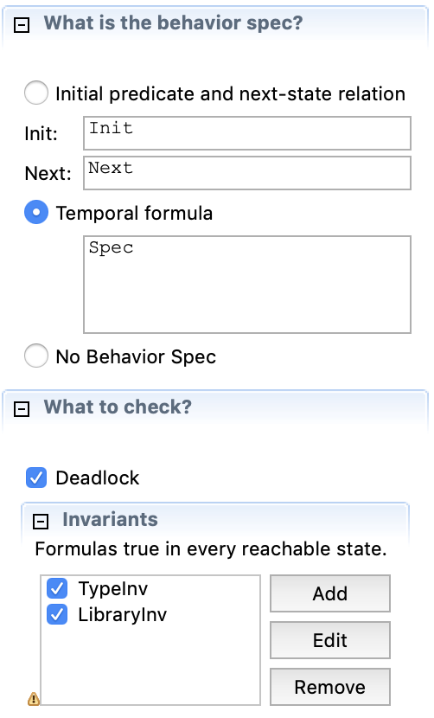
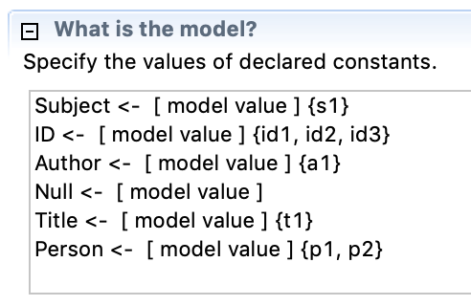
Try TLC
Specify the behavior of the spec.
Specify the atoms in the universe.
Specify the properties to check (invariants or liveness properties).

Slide 16
Checking properties
Invariants
Deadlock
Reach a state that No possible future steps can take, i.e.
All the pre-conditions are FALSE
LTL Properties (only supports [] and <>)
We can also treat an invariant as []P

Slide 17
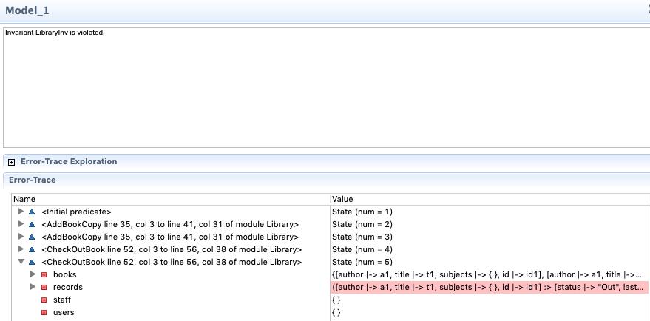
Found a design issue
TLC tells us from this trace, a user can check out more than 1 book. WHY?

Slide 18
Checking out a book
CheckOutBook(b, u) ==
/\ b \in books
/\ records[b].status = "In"
/\ records' = [records EXCEPT
![b].lastuser = u,
![b].status = "Out"]
/\ UNCHANGED <<users, staff>>
We forgot to check whether the user u has borrowed books already.

Slide 19
How TLC does Model Checking
Breadth-first search
S
Each path in the graph is an execution trace. The algorithm should skip the visited states. Then, it stops when all the reachable states are visited.
a
b
S_{a}’
S_{b}'
a
b
Can be configured to run depth-first search
Notes:
Compare the difference in model checking with LTSA and Alloy:
Alloy uses SAT solver, we have “if invariants are satisfied in state s and an operation f happens, then the next state s’ should also satisfy the invariants”
LTSA may also use some search algorithms (not sure). But sometimes, pre-post-conditions are easier to write. E.g., infusion pump power failure.

Slide 20
PlusCal
An algorithm language based on TLA+
Has C-like or Pascal-like syntax
Finally translated into TLA+ for model checking
Useful when modeling algorithms or protocols.
Notes:
You already know the execution sequence of a process. You want to check the concurrency issues when composing multiple processes.

Slide 21
Producer and Consumer Problem
A set of Producers
A set of Consumers
A product queue with maximum capacity N
Invariant: 0 <= Len(queue) <= N

Slide 22
Your first PlusCal spec
EXTENDS Sequences, Integers
CONSTANT Producer, Consumer
Max == 3
(* --algorithm ProducerConsumer {
variables queue = << >>;
...
} *)

Slide 23
Producer Process
process (producer \in Producer)
{
produce_forever:
while (TRUE) {
await (Len(queue) < Max);
queue := Append(queue, "Cake");
}
}
Create processes for all the producers in the set.
The process is blocked until the expression is true.

Slide 24
Consumer Process
process (consumer \in Consumer)
{
consume_forever:
while (TRUE) {
await (Len(queue) > 0);
queue := Tail(queue);
}
}

Slide 25
Use TLC to check the model
Define the model with 2 producers and 1 consumer
Define invariant,
Len(queue) <= Max
Will the system violate the invariant? WHY?

Slide 26
Translated spec
VARIABLE queue
ProcSet == (Producer) \cup (Consumer)
Init == (* Global variables *)
/\ queue = << >>
producer(self) == /\ (Len(queue) < Max)
/\ queue' = Append(queue, "Cake")
consumer(self) == /\ (Len(queue) > 0)
/\ queue' = Tail(queue)
Next == (\E self \in Producer: producer(self))
\/ (\E self \in Consumer: consumer(self))
An Atomic Step!

Slide 27
Labels in PlusCal
Code between labels are translated into one TLA+ operation
A TLA+ operation is an atomic step
The example code assumes that “checking the length” and “adding a product” is an atomic step

Slide 28
Add more labels
process (producer \in Producer)
{
produce_forever:
while (TRUE) {
notfull:
await (Len(queue) < Max);
produce:
queue := Append(queue, "Cake");
}
}

Slide 29
Add more labels
process (consumer \in Consumer)
{
consume_forever:
while (TRUE) {
notempty:
await (Len(queue) > 0);
consume:
queue := Tail(queue);
}
}

Slide 30
Translated spec
produce_forever(self) == /\ pc[self] = "produce_forever"
/\ pc' = [pc EXCEPT ![self] = "notfull"]
/\ queue' = queue
notfull(self) == /\ pc[self] = "notfull"
/\ (Len(queue) < Max)
/\ pc' = [pc EXCEPT ![self] = "produce"]
/\ queue' = queue
produce(self) == /\ pc[self] = "produce"
/\ queue' = Append(queue, "Cake")
/\ pc' = [pc EXCEPT ![self] = "produce_forever"]

Slide 31
pc, stack, and self
pc: program counter is used to control the execution sequence of a process.
stack: is used to track the local variables of procedures (functions).
self: the identifier for each process.

Slide 32
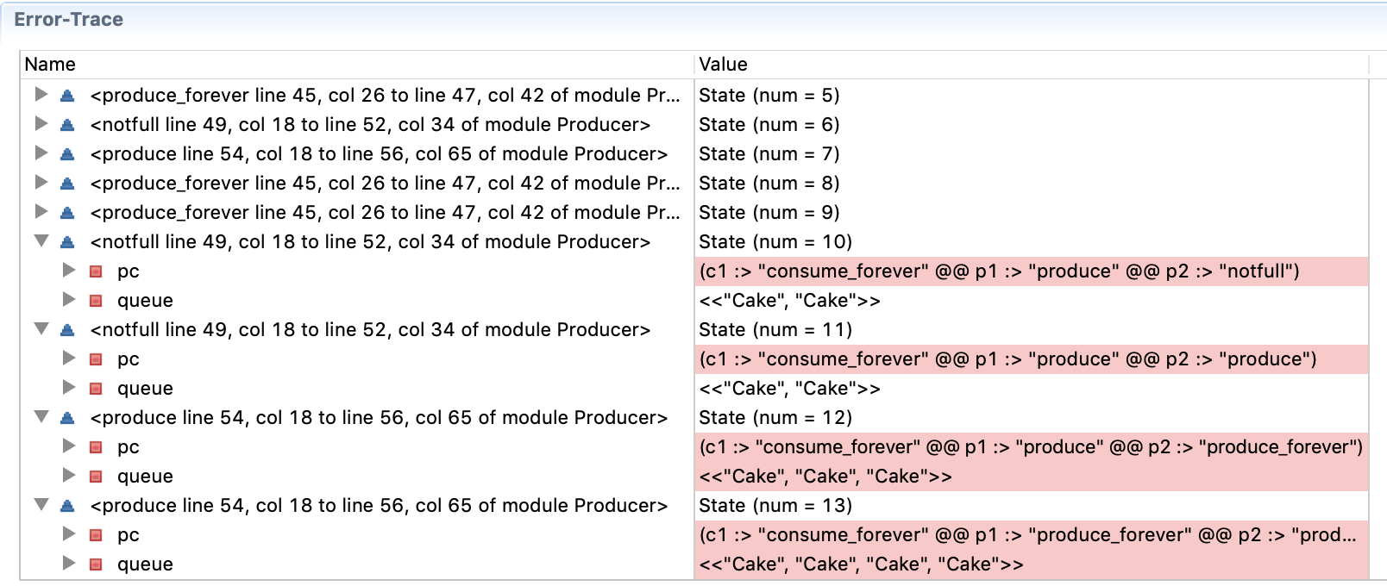
Error trace found by TLC

Slide 33
Alloy vs. TLA+
Alloy
TLA+
First-order relational logic
Language more expressive
Based on SAT solving
Common use cases:
Synthesis a model
Check assertions
State machine model
PlusCal is more attractive to developers
Graph search based checking
Common use cases:
Find a trace to a property violation
Check LTL properties

Slide 34
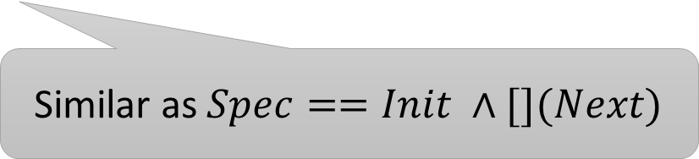
Traces in Alloy
Time is a set of discrete time stamps (or steps in an execution).
sig Time { ... }
fact traces {
first.init
all t: Time – last | let t’ = t.next | next[t, t’]
}
run {} for 3 but 7 Time
Similar as $Spec==Init ∧[](Next)$
Only within 7 steps! But in practice, many bugs can be found in a few steps.

Slide 35
Example: ROS Reconfiguration
For a Pub/Sub styled system,
where A and B are two components, T is a topic.
Safely replace component A with A’ in runtime.
A reconfiguration process can divided into four basic operations:
detach, remove, create, attach
An algorithm should translate any reconfiguration command to these 4 operations.
The system should satisfy some property P during the reconfiguration.
A
A’
T
T
B
B

Slide 36
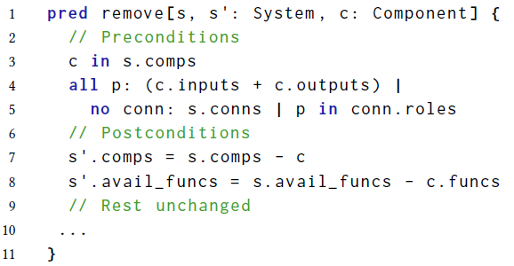
The Alloy Model
Use Alloy to define the pre- and post-conditions for each atomic action.
Assert: under any system state, the reconfig action should maintain the property.

Slide 37
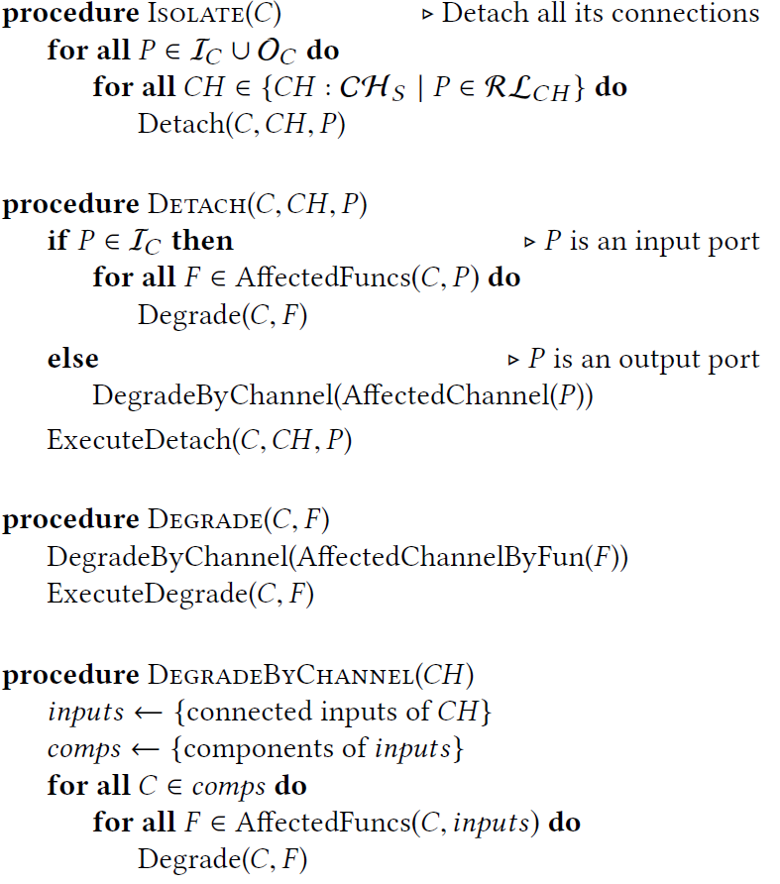
The TLA+ Model
An algorithm that translate a command (e.g., replace) to a sequence of atomic reconfig actions.
Use PlusCal to model the algorithm
Check the algorithm under a specific architecture.

Slide 38
Other Resources
https://lamport.azurewebsites.net/tla/tla.html
https://github.com/tlaplus
https://groups.google.com/forum/#!forum/tlaplus
Specifying Systems, by Leslie Lamport
Practical TLA+ https://www.apress.com/de/book/9781484238288

Slide 39
CounterSquare Example
CounterSquare == (
[x: N, y : N],
{[x = 0, y = 0]},
{inc},
T_{inc} ), where
inc
pre true
post x’ = x + 1 /\ y’ = y + 2x + 1
)

Slide 40
Your First TLA+ Spec
Use EXTENDS keyword to import other modules
EXTENDS Integers
VARIABLES x, y
Init == x = 0 /\ y = 0
Inc == /\ x' = x + 1
/\ y' = y + 2 * x + 1
Next == Inc
Use VARIABLES keyword to define state variables
“Identifier == expression” defines predicates or functions. Init defines the initial states; Inc defines the increasing operation.
Next defines all the possible actions.

Slide 41
Define Invariants
TypeInv == /\ x \in Int
/\ y \in Int
CounterSquareInv == x * x = y
TLA+ is untyped! We define a type invariant to assert the types of the variables. (But Optional!)

Slide 42
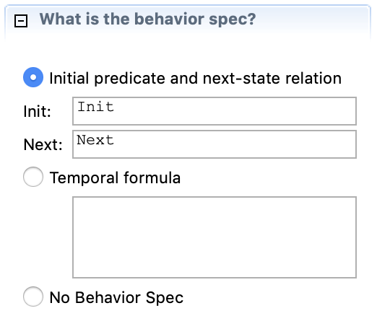
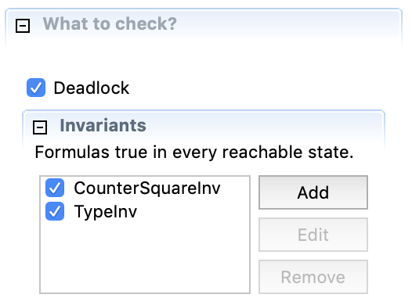
Try TLC Model Checker
What is the behavior of a system? How can we generate it?

Slide 43
How TLC does Model Checking
Breadth-first search
S
Each path in the graph is an execution trace. The algorithm should skip the traversed states. Then, it stops when all the reachable states are traversed.
a
b
S_{a}’
S_{b}'
a
b
Can be configured to run depth-first search
Notes:
Compare the difference in model checking with LTSA and Alloy:
Alloy uses SAT solver, we have “if invariants are satisfied in state s and an operation f happens, then the next state s’ should also satisfy the invariants”
LTSA may also use some search algorithms (not sure). But sometimes, pre-post-conditions are easier to write. E.g., infusion pump power failure.

